Slide 1
STUDY SKILLS

Slide 2
STUDY SKIILS
Study skills are the techniques and strategies used to effectively gather, retain and apply information such as time management, note-taking, active learning, memorization, test preparation etc.

Slide 3
NOTE-TAKING AND NOTE-MAKING
Note-taking is the fundamental academic activity that involves writing or recording what is taught in the classroom, while note-making is the process of developing the notes written in class to form a comprehensive and personal note/study material. Note-taking is done in the class while note-making is done while reading which makes it a more active activity.

Slide 4
THE IMPORTANCE OF NOTE-TAKING AND NOTE-MAKING
Better notes will help you remember concepts, develop meaningful learning skills, and gain a better understanding of a topic. Learning how to take better study notes in class helps one to recall and understand what you have learnt because it:
Ensures you actively listen to what the teacher says
Requires you to think about what you have written
Helps you make connections between topics
Helps you to structure, prioritize and organize information
Serves as quality review material for after class

Slide 5
METHODS OF NOTE-TAKING
Using different note-taking methods is important, especially as you progress through high school and transition to university. There are several note-taking techniques you can use to start taking better notes in class, some of which are:
The Cornell Method
The Mapping Method
The Outlining Method
The Charting Method
The Sentence Method

Slide 6
THE CORNELL METHOD
The Cornell note-taking method helps organize class notes into easily digestible summaries. This method is effective because the main points, details, study cues, and summary are all written in one place. The paper is divided into 3 sections: right side for class note section, left margin for after class reading and the third part for summary.

Slide 7
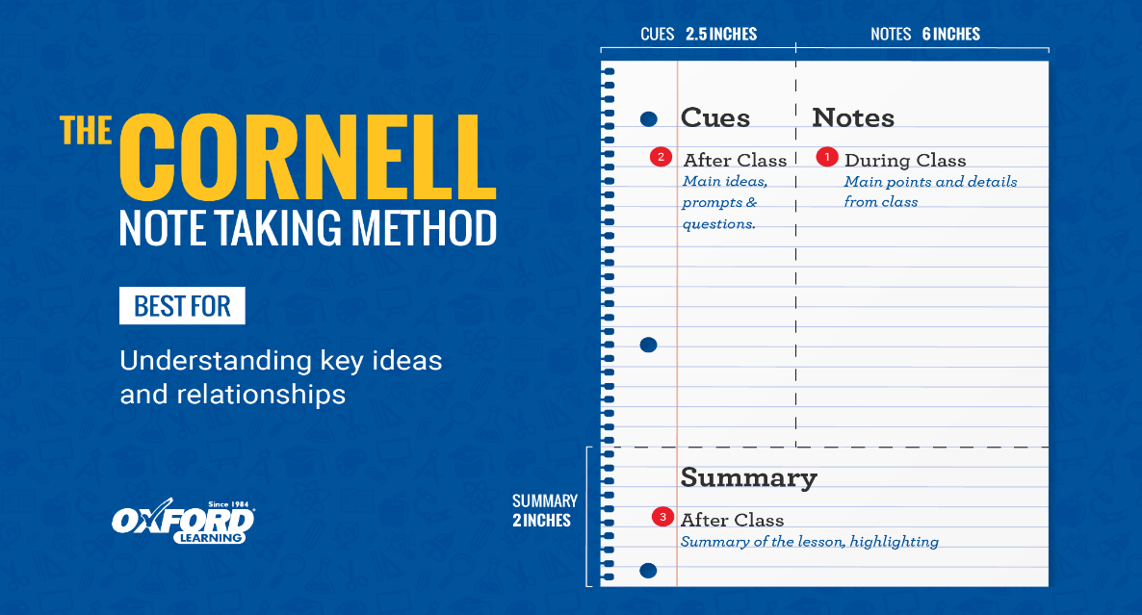
THE CORNELL METHOD

Slide 8
THE MAPPING METHOD
The Mapping note-taking method is a more visual way to organize your class notes. This technique is useful when learning about relationships between topics. The page is organized by topic. The main topics branch out into subtopics with detailed information about each.

Slide 9
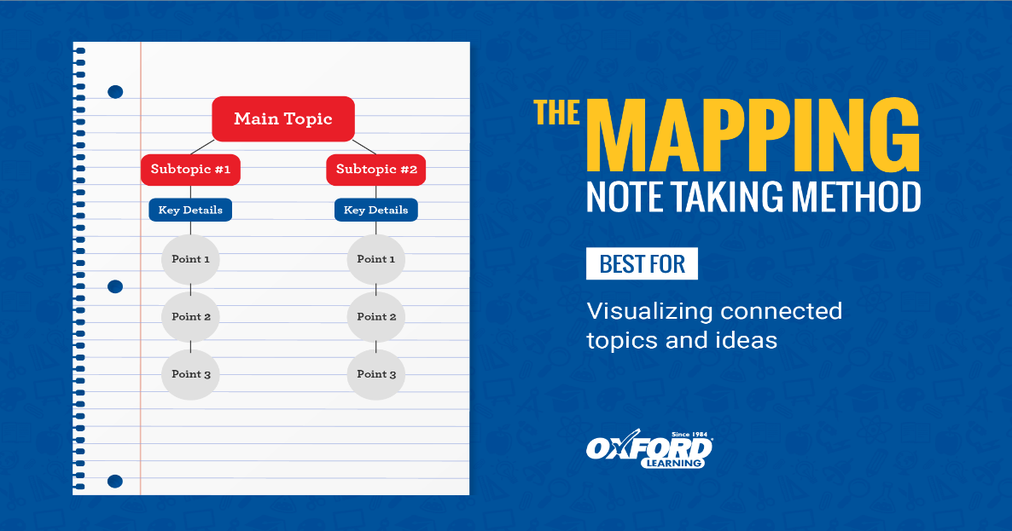
THE MAPPING METHOD

Slide 10
THE OUTLINING METHOD
The Outlining note-taking method uses headings and bullet points to organize topics. This method is most useful when learning about topics that include a lot of detail.
ADVANTAGES:
It allows notes to be neatly organized.
It is easy to see the relationship between topics and subtopics.
It is easy to turn points into study questions.
Each section starts with a heading of the main topic. Each subtopic and supporting fact is written underneath the proper heading

Slide 11
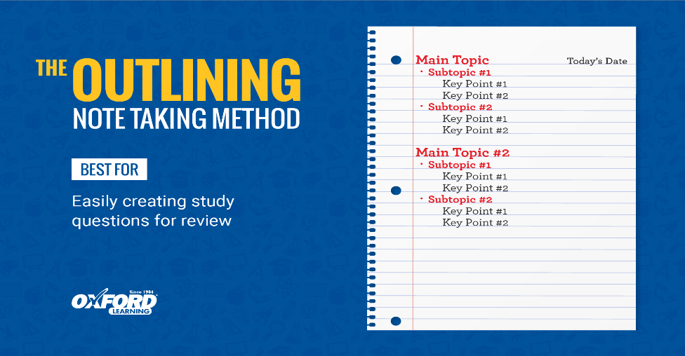
The outlining method

Slide 12
The charting method
Charting note-taking method uses columns to organize information. This method is useful for lessons that cover a lot of facts or relationships between topics.
The page is divided into columns labeled by category. The details of each category are filled out in the rows below.

Slide 13
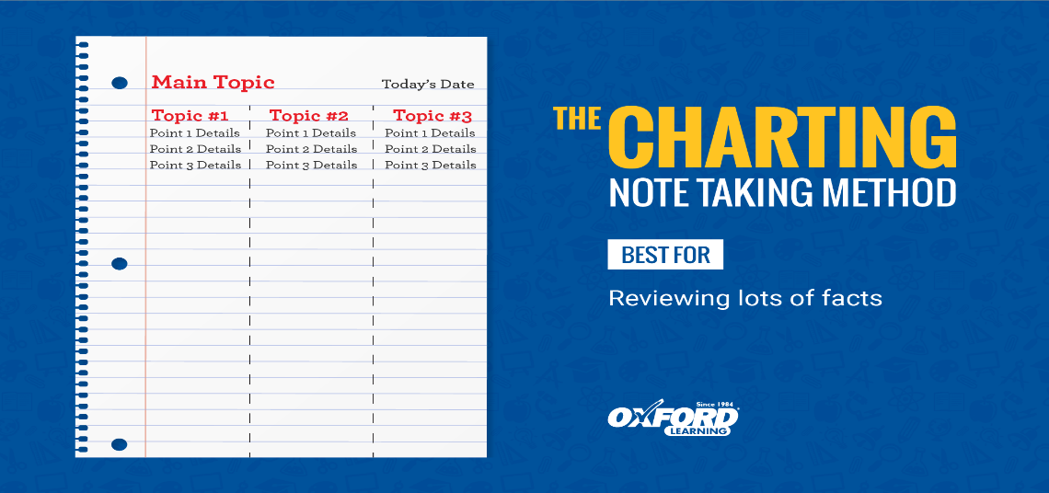
The charting method

Slide 14
The sentence method
The Sentence note-taking method is simply writing down each topic as a jot note sentence. This method works well for fast paced lessons where a lot of information is being covered. Jotting main points helps you determine which information is important and which is not. Furthermore, you are able to cover a lot of details and information quickly; notes are simplified for study and review
Each line on the page is a new and separate point. To organize your notes even more, you can use headings for each main point.

Slide 15
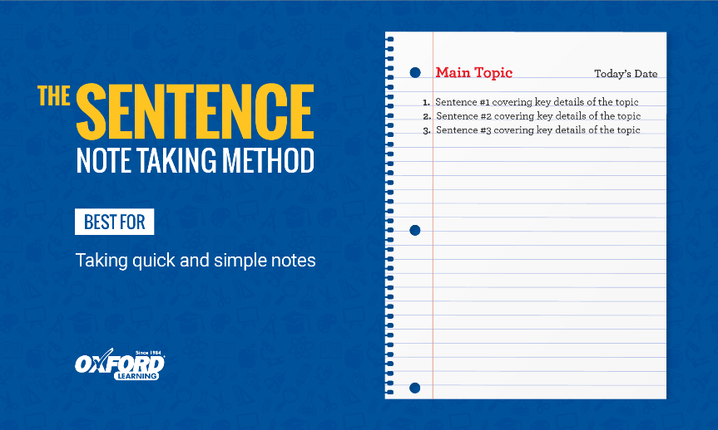
The sentence method

Slide 16
Guidelines to effective note-taking and note-making
Read
Listen
Write only what is needed
Organise your notes
Review your note

Slide 17
Read
Read any background texts that have been suggested, re-read your notes from previous lectures or classes so that you can see easily where the current session fits into the overall pattern of the subject.

Slide 18
Listen
The key to good note-taking is to understand the lecture. It is easier to understand a lecture when you listen to it rather than by trying to re-construct it from half-understood notes afterwards. Simultaneously listening to the lecturer and writing down the key points is not a skill that comes easily to most people but it is important to cultivate this in order to become a really effective learner.
Pick up on the phrases, voice changes and other, sometimes non-verbal, cues that the lecturer uses to communicate which are the key points of the session. These are the most important things to get into your notes; you don’t want to miss them!
Be an active listener. Think about what’s being said. How do the different points connect with one another? How do the issues raised in this lecture relate to issues that have been discussed in previous sessions, or in books you have read? Make sure that you transcribe your understanding of these connections and relationships into your notes.

Slide 19
Write only what is needed
Not everything in a lecture or seminar session will be of equal significance. There will probably be three or four main points, linked by a common theme. The rest of the class may well be illustrations, examples, exercises, student interactions and responses to questions, etc. Don’t try to write down every word or detail. Capture the major points, with sub-headings if necessary, and explain them in your own words if you have time to do so. If you don’t have time, leave a blank space beneath the point in question and a little note or symbol in the margin to remind you to re-visit that point later.

Slide 20
Organise your notes
Beautifully scripted and perfectly laid-out notes are not necessary for effective learning but some level of organization is useful if you are going to be able to make sense of them in the future. Develop a system of highlighting headings and sub-headings (using bullet points, underlining, indenting, etc.) that makes intuitive sense to you and stick with that from lecture to lecture.
Try to be consistent as well with the use of abbreviations and symbols in your notes. If you can develop and use your own system of shorthand, you can speed up your note-taking but this is only a useful technique if you can decipher that code when you come to re-read your notes later.
Don’t try to cram too much writing on a single page, or make your writing so small that it’s illegible. Use as much paper as you need to express all the ideas from the lecture in a clear and readable form. Draw diagrams or use flow charts or mind maps if they help you make sense of your ideas.
Following the Cornell system for writing notes can also increase the efficiency and effectiveness of your note-taking technique. This involves leaving a margin down the left hand side of the page, approximately 1/3 of the total width of the page, and only writing your notes to the right hand side of that margin during class. The third of the page to the left of the margin is reserved for pulling out the key ideas and themes from the notes when you come to review them later.

Slide 21
Review your note
The beauty of the Cornell system is that it doesn’t require you to re-write your notes, thus saving time and stress. You do need to review your notes, however, within 24 hours of their original creation. Re-reading shortly after writing notes means that you will be more likely to remember and understand them, and the process of pulling out the key ideas from the lecture in the left hand column of your note sheets will therefore be very much smoother.
As far as possible, aim to write the key ideas in the review column in your own words, summarizing what have been the main points of the lecture for you. Stress inter-relationships and any other factors that add to your recollection or comprehension of the material.

Slide 22
CLASS ACTIVITY
Do the following class activity in groups.
As a diligent student, you took note on the importance of note-taking and note-making using the mapping method. Form a comprehensive note of your own detailing about seven importance.

